Slide 1
Translating Expression & Equations- Notes
Follow along the slides and write down all things in red. These are your notes

Slide 2
We are learning how to change algebra into words: 7x = 7 times x
& words into algebra: Eight plus a number = 8 + n

Slide 3
Important Vocab!!

Slide 4
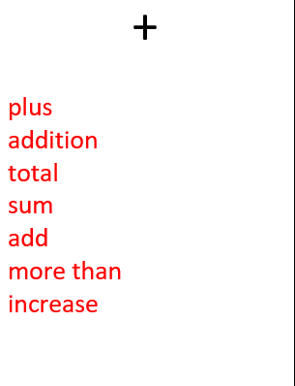
Words that mean addition:

Slide 5
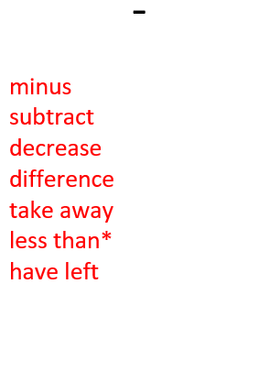
Words that mean subtraction:

Slide 6
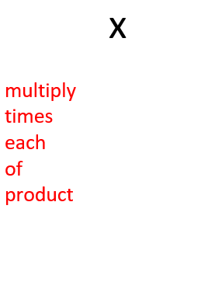
Words that mean multiplication:

Slide 7
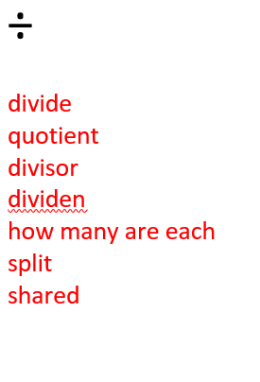
Words that mean division:

Slide 8
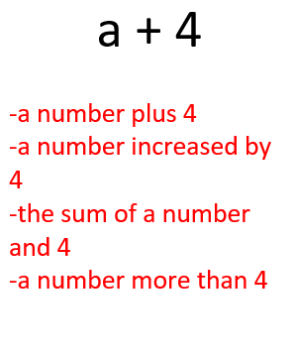

Slide 9
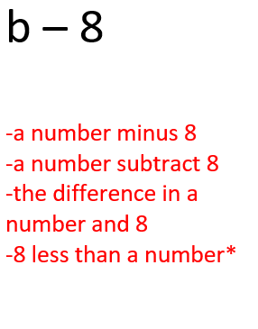

Slide 13
Examples:

Slide 15
Examples:

Slide 16
You Try!

Slide 17
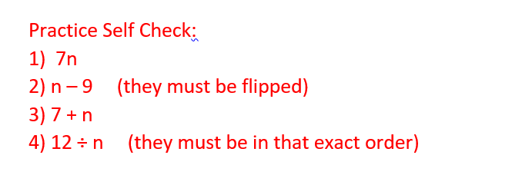
Self Check: How did you do?

Slide 24
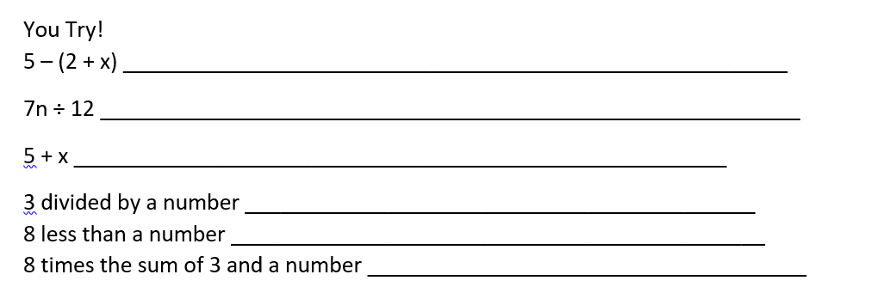
Practice!

Slide 25
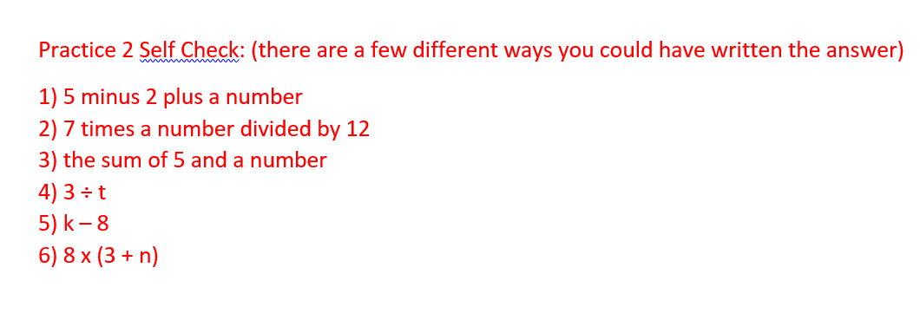
Self Check! How did you do?

