Slide 1
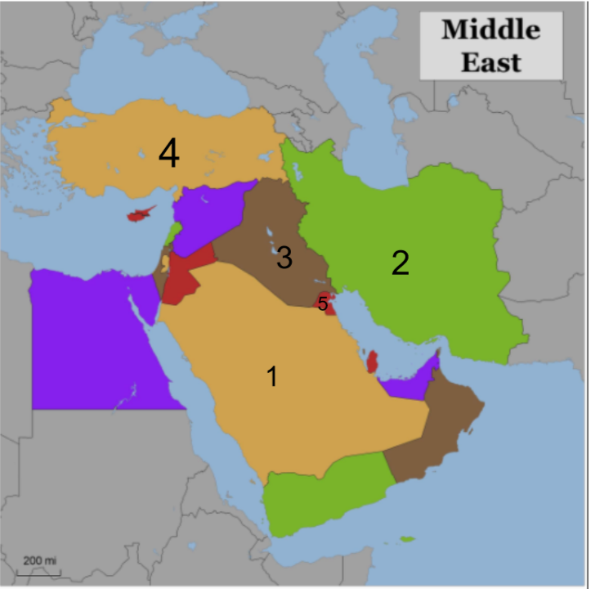
Throwback Tuesday?
Can you label the following countries on the map?

Slide 2
Way Back Wednesday?
Name the 3 ethnic groups in the Middle East

Slide 3
Environmental Issues in Africa

Slide 4
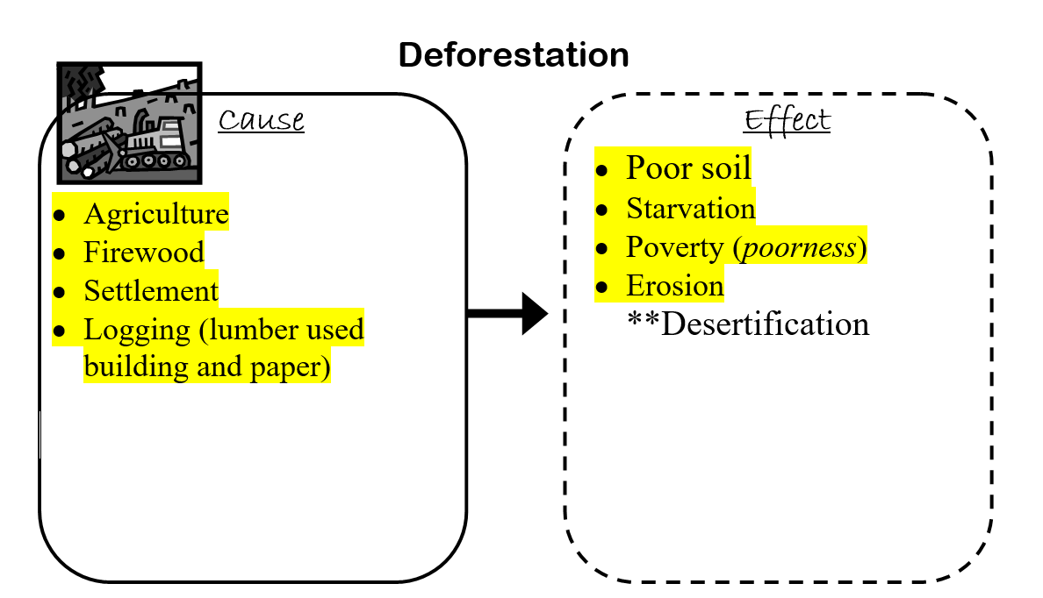

Slide 5
Solutions?
Replant trees
Only cutting down what you NEED
Laws about cutting down trees
Use alternate materials

Slide 6
Slash & burn agriculture?
Causes deforestation
Pollutes the soil for farming

Slide 7
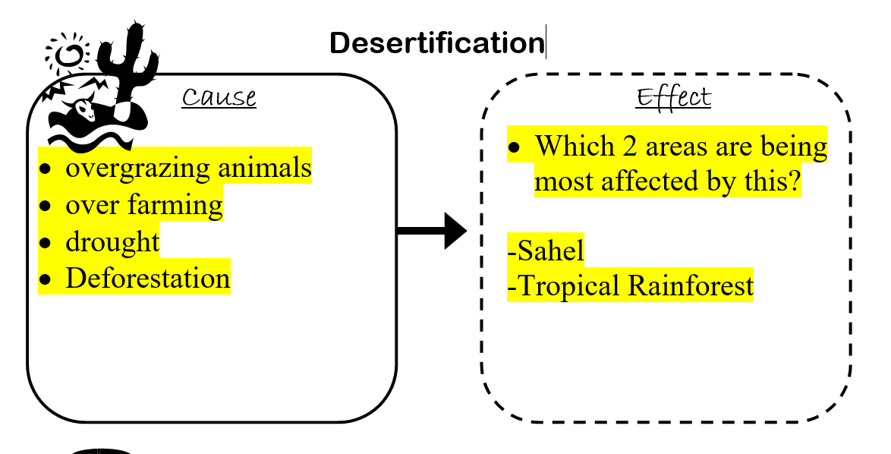

Slide 8
Solutions?
Limit tree cutting down
Limit grazing
Plant plants
Protect the rainforests

Slide 9
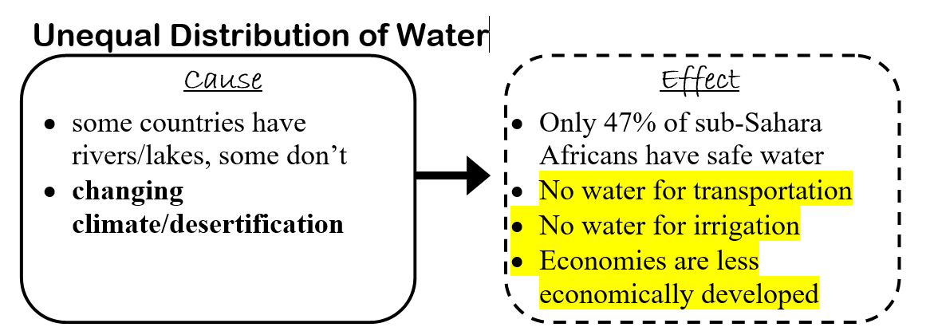

Slide 10
Solutions?
Irrigation
Move closer to water

Slide 11
What is irrigation?
Supplying water through ditches, pipes, or canals to areas without water
** to help grow crops

Slide 12
Why irrigation in Africa?
To increase the amount of farmable land

Slide 13
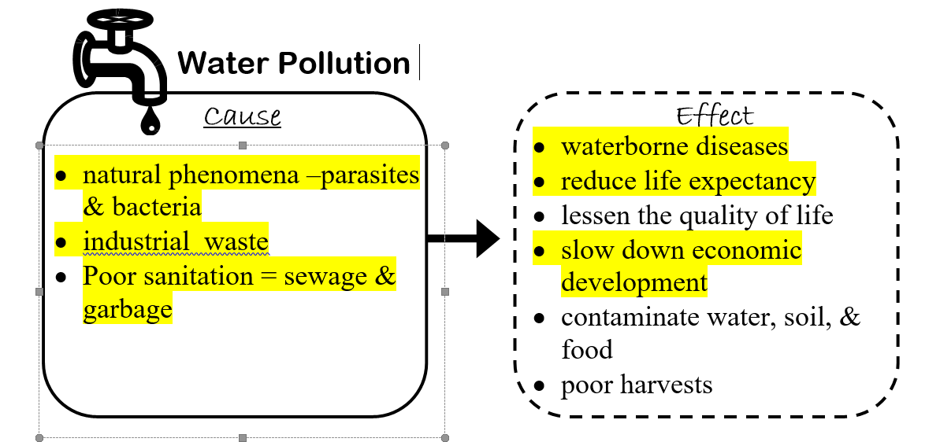

Slide 14
Solutions?
Water treatment plants
REDUCE REUSE RECYCLE

Slide 15
Poor soil leads to…
Land becoming useless for farming

