Slide 1
Area, Surface Area, and Volume
Use your formula sheet!

Slide 2
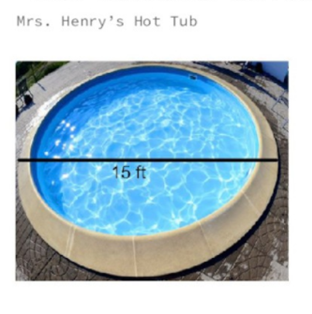

Slide 3
FREE SPACE
Skip the ice cream cone

Slide 4
If the circumference of a circle is 28.26 cm, what is the diameter?

Slide 5
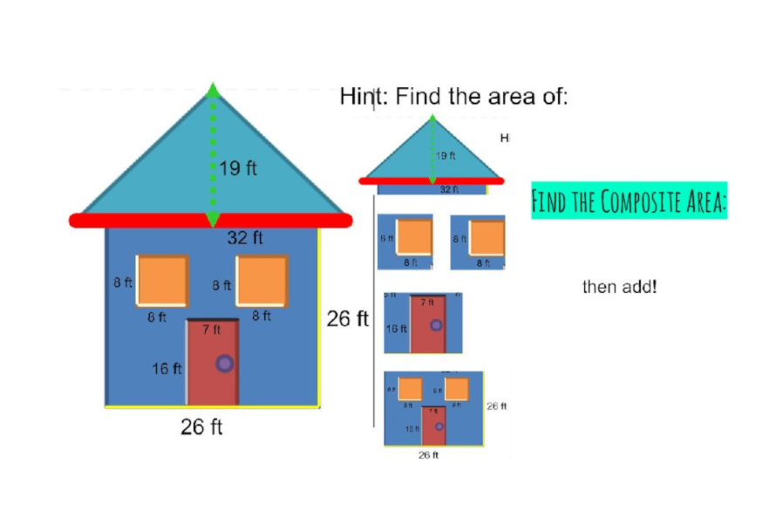
Find the area of the triangle
Find the areas of the windows
Find the area of the door
Find the area of the house
ADD!

Slide 6
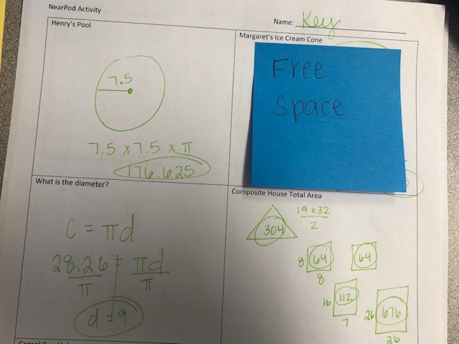
Check your answers, fix your mistakes
Answer = 1,220

Slide 7
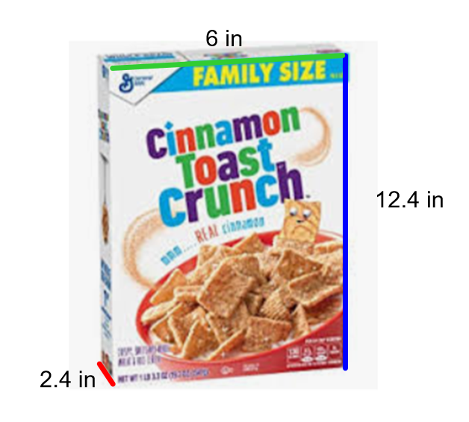
Find the volume of the cereal box

Slide 8
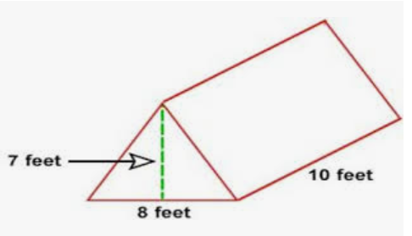
Find the volume of the tent

Slide 9
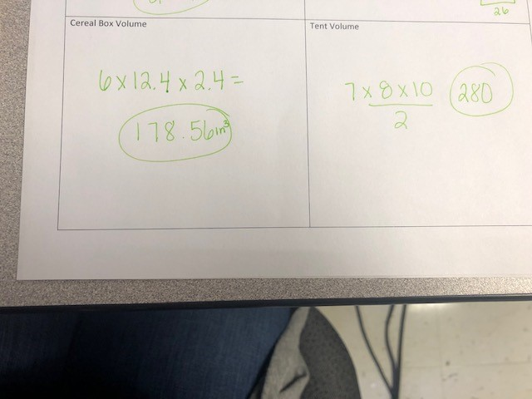
Check your answers, fix your mistakes

Slide 10
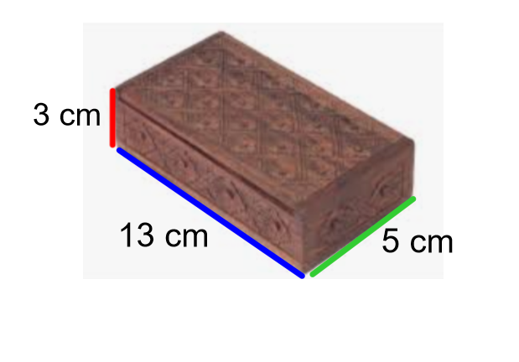
You are paining the box. You want to paint all of the sides except the bottom. Find the surface area:

Slide 11
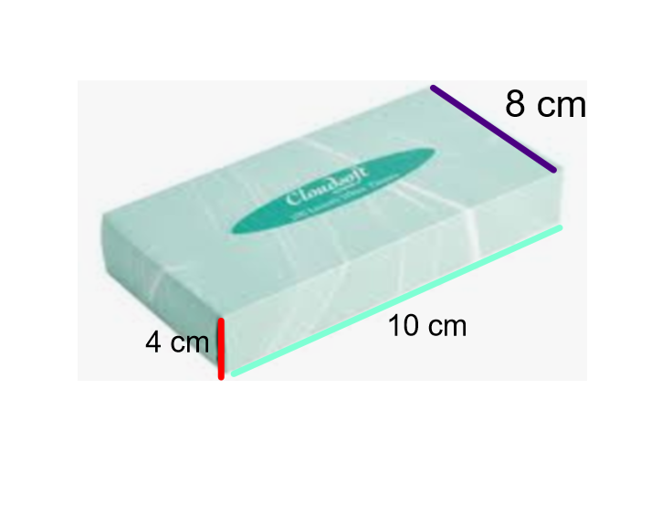
Find the surface area of the prism

Slide 12
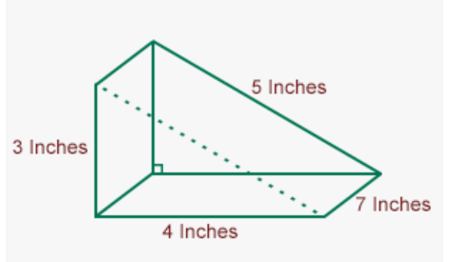
Find the surface area of the prism:

Slide 13
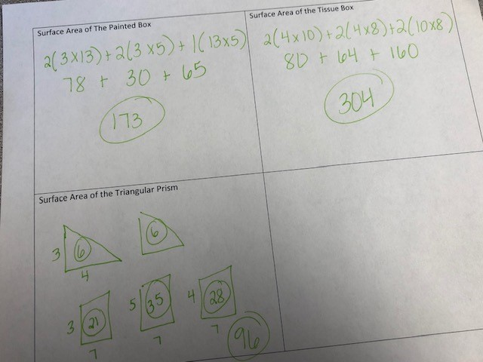
Check your answers, fix your mistakes

